Slide 1
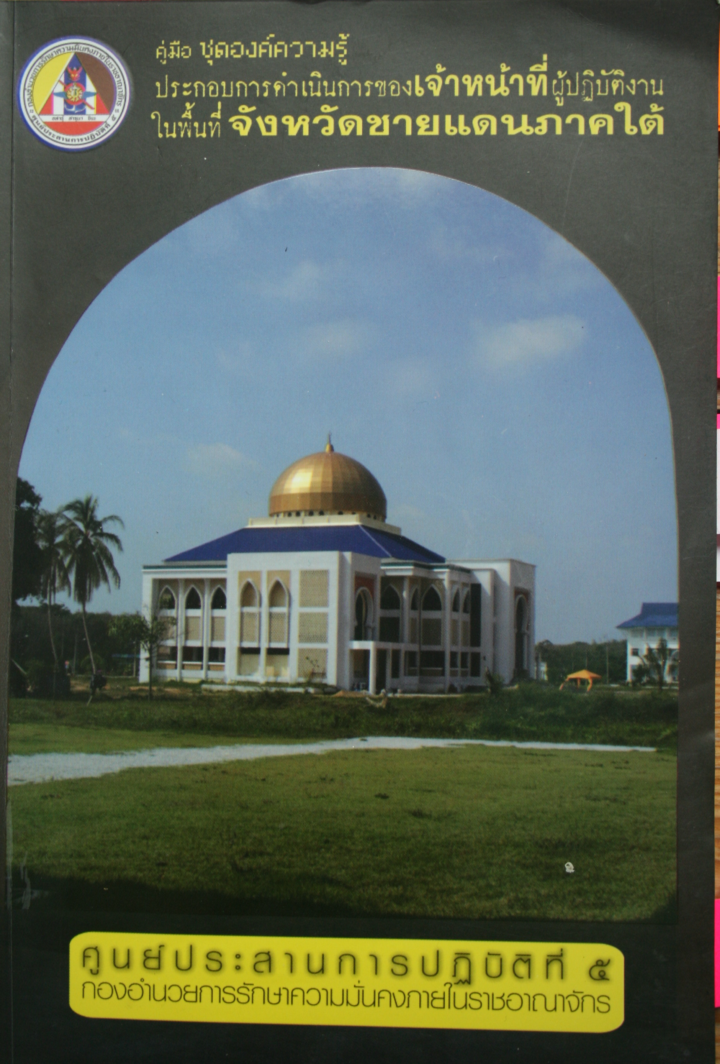

Buddhist Secularism?
Genealogies of ‘Buddhist Modernity’ and the Production of Handbook Knowledge on Islam in Thailand
Ruth Streicher, Freie Universität Berlin
Introduction
One of the most prominent concerns of scholarly literature on Thailand is the relationship between the state and Buddhism. However, this one-sided focus on Thailand as a Buddhist nation-state has reproduced two significant short-comings.
First, on an empirical level, the factual existence of religious pluralism in Thai-land tends to be overlooked. Besides numerous Christian communities, Thai-land’s Muslim community is the most important religious minority and compri-ses around three million people – or 5 % of the total population.
Second, on a theoretical level, the assessment of an ‘amalgam’ of ‘state Buddhism’ has often risked a conceptual collapse of the ‘state’ and ‘Buddhism’ that has decisively limited analytical under-standings of a more complex confi-guration of state power in Thailand.
This configuration is indeed quite compli-cated. Thus on the one hand, religious pluralism is officially promoted as a way to foster Thailand’s ‘religious diversity’, and constitutionally anchored in the right to religious freedom – often considered to be the cornerstone of modern secular statehood. On the other, Thailand’s Buddhist monarch is assigned the legal patron of all of Thailand’s religious communities, and the right to religious freedom is often justified by referring to Buddhist tolerance and respect.
Aims and Questions
My aim in deploying the provocative term ‘Buddhist secularism’ is to open a fresh analytical angle from which to pose the question about religion and politics in Thailand in more complicated terms. This inquiry will moreover contribute to a conceptual discussion about forms of secularism that are distinct from but entangled with paradigmatic Western formations.
Using Talal Asad’s alternative analytic of secularism as a conceptual starting point, I will ask
historically how the ‘semi-colonial’ emergence of the Thai nation-state not only came with the normative en-hancement of a specific version of Buddhism as the new national religion, but was also constituted in relation to a distinct construction of Islam and the Muslim community in Thailand;
how this historically grown discursive formation that may be called ‘Buddhist secularism’ manifests in a contempo-rary form of knowledge production, which I will explore by example of recent governmental handbooks on Islam in Thailand.
a) Genealogies of Buddhist Modernity
Until today, Thai nationalist historiography is based on the narrative that the modern Thai nation-state was built by the so-called ‘modernizing monarchs’ at the turn of the 20th century. These are hailed as having saved Thailand from colonization by establishing Thailand’s own alternative ‘Buddhist modernity’. Crucially, it was also under the rule of these ‘modernizing monarchs’ that a former Muslim sultanate was annexed into national territory, and Buddhist kings suddenly had to rule over a large Muslim community.
In this historical section, I want to deepen a relational perspective on the narrative of ‘Buddhist modernity’ during the formation of the modern Thai nation-state. Most importantly, I will explore how certain elements of ‘Buddhist secularism’, such as the notion of religious freedom under Buddhist patronage, are historically related to the effort of Buddhist monarchs to rule the Muslim south in what they considered to be a ‘modern’ way.
b) The Production of Handbook
Knowledge on Islam in Thailand
Cover of a Handbook for State Officials Working in the Three Southern Provinces, ISOC, 2010
The production of governmental hand-books on Islam in Thailand has flourished during the last decade. These handbooks have been published by different govern-mental departments, and are designed to teach state officials the ‘correct know-ledge’ about Islam to foster their ‘cultural understanding’ with the Muslim population in Thailand’s south. My exploration of these handbooks will evolve into two directions.
First, the very production of such hand-books has to be scrutinized as a material practice of regulating the Muslim com-munity within the modern Thai nation-state project. Second, the contents of these handbooks will be examined more closely to explore discursive articulations in both textual and visual representations. I understand these representations as practices that are productive in forging specific claims to truth with regards to both, a distinct form of behavior deemed appropriate for modern state officials, and particular truth claims about the ‘Muslim subjects’ they are taught to relate to.
German Host: Prof. Dr. Schirin Amir-Moazami, Freie Universität Berlin
Foreign Host: Prof. Saba
Mahmood, University of
California, Berkeley

